Slide 1


CASE 4 - CryptoANalytics. CLIENT – ERSAN DURAN
Group 5 – team members
Muneeba Nawaz
Ademola Oladimeji
Olumuyiwa Olajuwon
Madhav Thodindala
Susan Dangana
Michael patrick
MUNEEBA NAWAZ
ADEMOLA OLADIMEJI
OLUMUYIWA OLAJUWON
MADHAV THODINDALA
SUSAN DANGANA
MICHAEL PATRICK

Slide 2
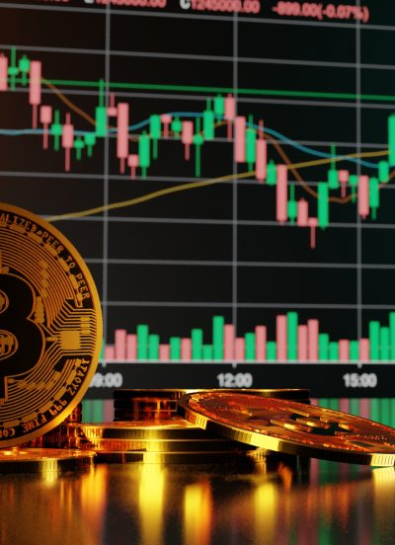
Core Project Aim
Application of statistical and computational techniques to predict the price of Bitcoin.
Exploratory and Inferential Analysis

Slide 3
OUR THOUGHT PROCESS
INFERENTIAL ANALYSIS
FINDINGS AND RECOMMENDATIONS
Exploratory Analysis

Slide 4
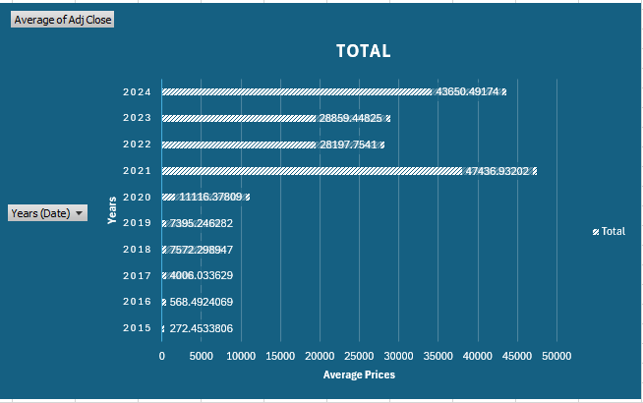
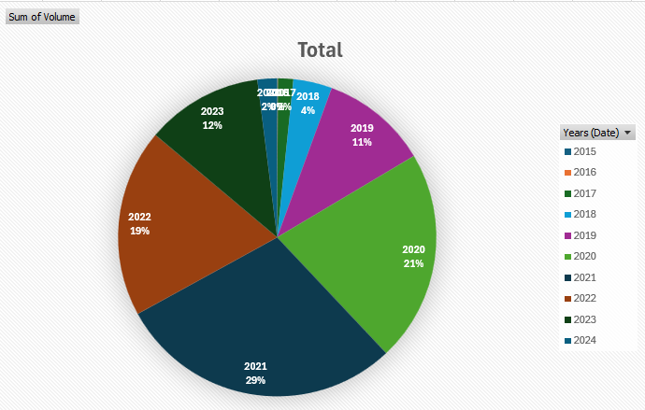
EXPLORATORY ANALYSIS (Descriptive analysis)
BITCOIN PRICE
BITCOIN TRADING VOLUME

Slide 5
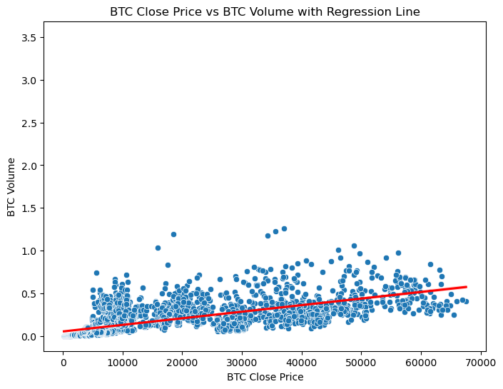




Scatter plot showing the correlation between BTC price and BTC trade volume

Slide 6
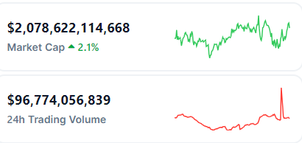
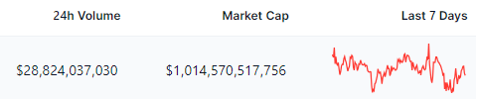

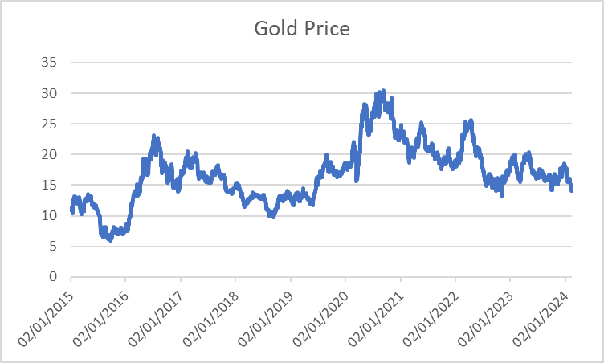
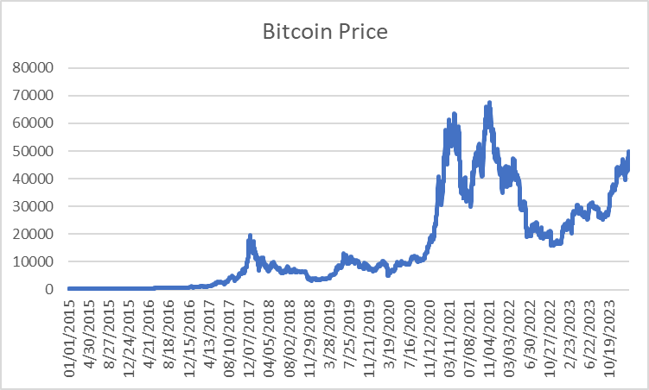
Key indicators

Slide 7
INFERENTIAL ANALYSIS (Machine Learning)
random forest
2
Bagging classifier, and gradient boosting classifier
3
Supervised learning –
Logistic regression
1

Slide 8
MODEL PRECISION / ACCURACY SCORE
LOGISTIC REGRESSION:
Precision: 0.76
Accuracy: 0.68
BAGGING CLASSIFIER:
Precision: 0.76
Accuracy: 0.75
RANDOM FOREST:
Precision: 0.76
Accuracy: 0.74
GRADIENTBOOSTING CLASSIFIER:
Precision: 0.77
Accuracy: 0.75
When we added Gold Price to the Model:
Precision: 0.79 – Accuracy: 0.79

Slide 9
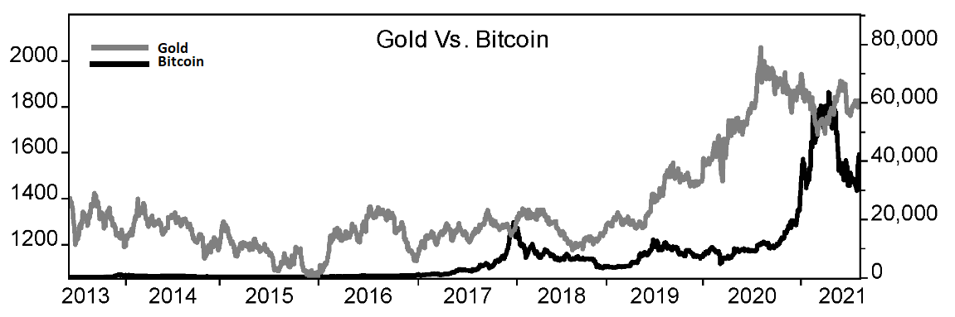
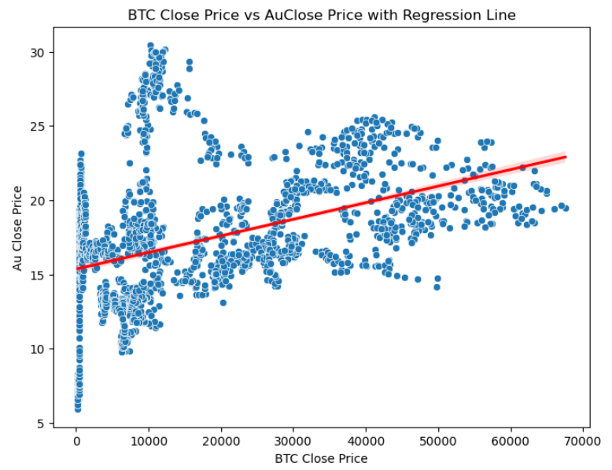
Correlations / relationships between crypto and/or traditional asset classes

Slide 10
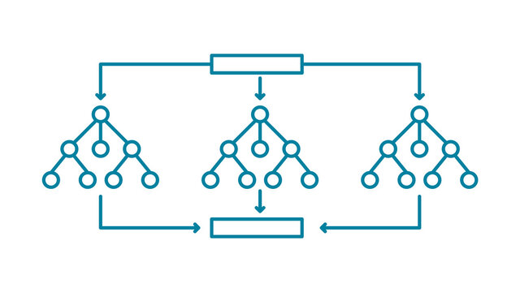


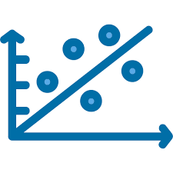
CHOSEN ANALYTICAL TECHNIQUES JUSTIFICATION
PREDICTION
DESCRIPTION
CORRELATION
RandomForest /GradientBoosting /Bagging Classifier has high accuracy precision, and deals with outliers better than others.
Line graph helps use to track changes over long period of time.
Pie chart shows the total percentage of trade volume for each year
We used Scatter plot to determine whether or not Bitcoin prices and Bitcoin trade volume have a relationship or correlation.

Slide 11
RECOMMENDATIONS
Further explore and refine the model by integrating additional features and data sources, such as sentiment analysis from social media and news sources.

Slide 12

THANK YOU...

